Slide 1

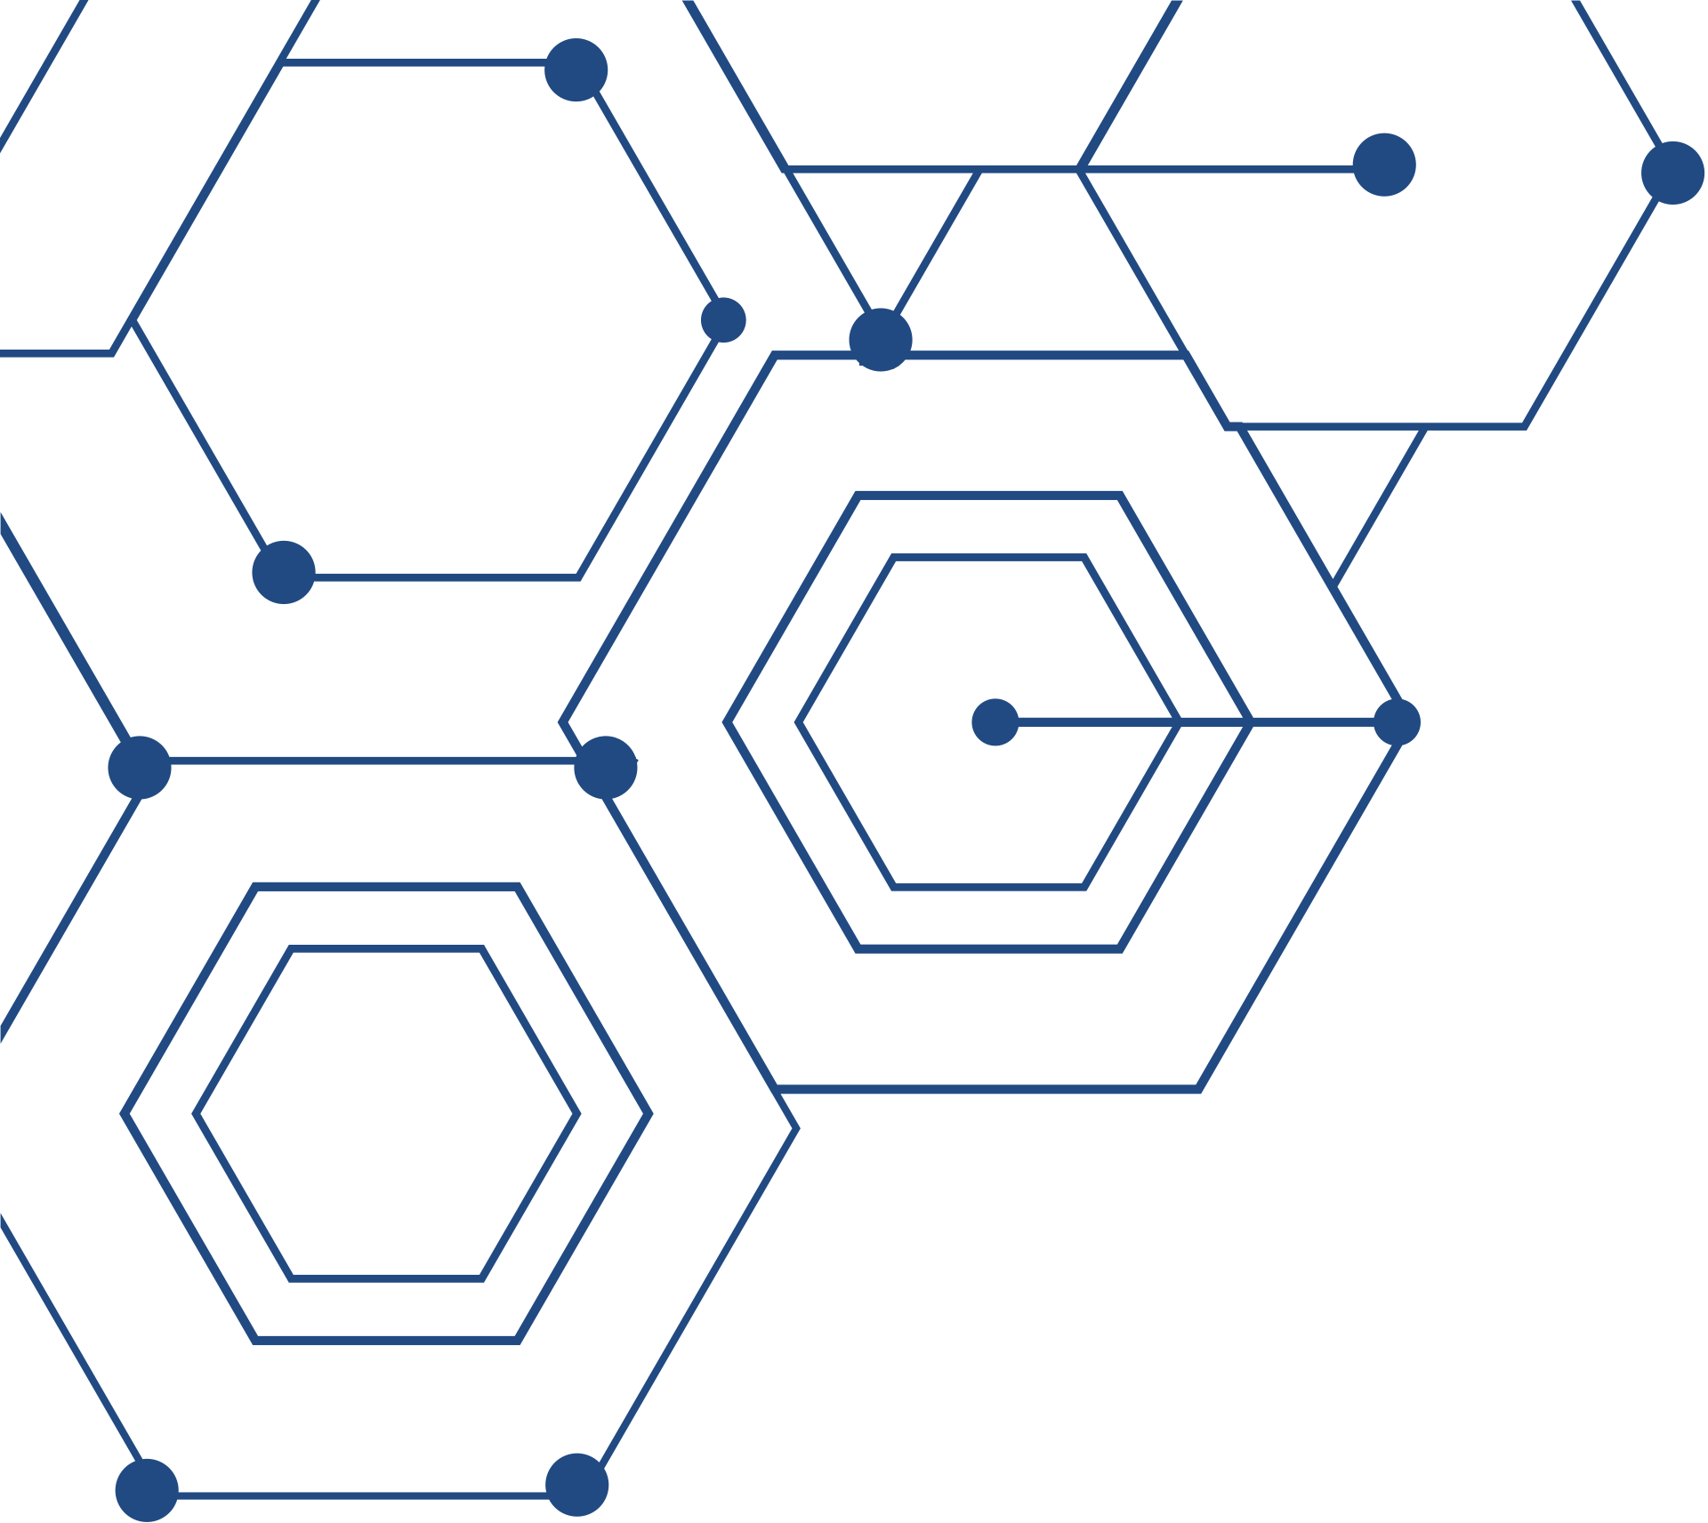
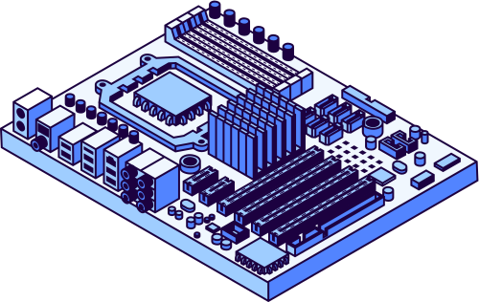
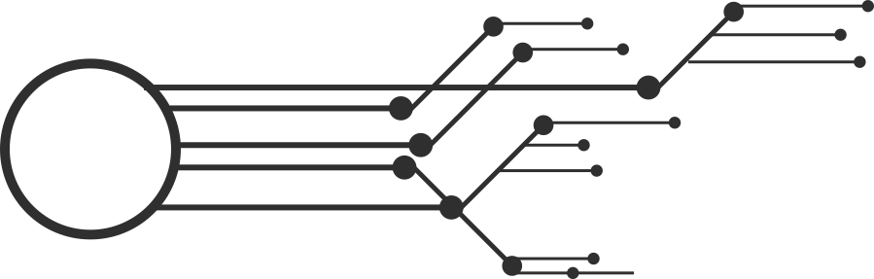

circuitScan
Presented by: Shahil Merchant, Adam Gilmore, Nyah Funderburke, Patrick Carigan, and Shavonna Simpson

Slide 2
US TARGET MARKET (ARR)
Pro: $600/mo (25%)
Enterprise: $800/mo (75%)
Average Price: $750/mo
$187.5MM
$112.5MM
`
$9MM
TAM
SAM
SOM
250,000
Electrical Engineers
60%
In Sales/Design
8%
In Santa Clara

Slide 3


Component identification​ | ✅ | ❌ | ✅ | ✅
Links to information / buy​ | ✅ | ✅ | ✅ | ✅
Alternative Chip Suggestions ​ | ❌ | ❌ | ❌ | ✅
Can reverse search by part marking ​ | ❌ | ❌ | N/A | ✅
Database of circuit boards ​ | ❌ | ✅ * | N/A | ✅
Price | $0 | $0 | $550-$2000 per “scan” | $600-$800 per month
COMPETITION
PCB Reverse Engineering Services
circuitScan
*limited user uploaded database

Slide 4

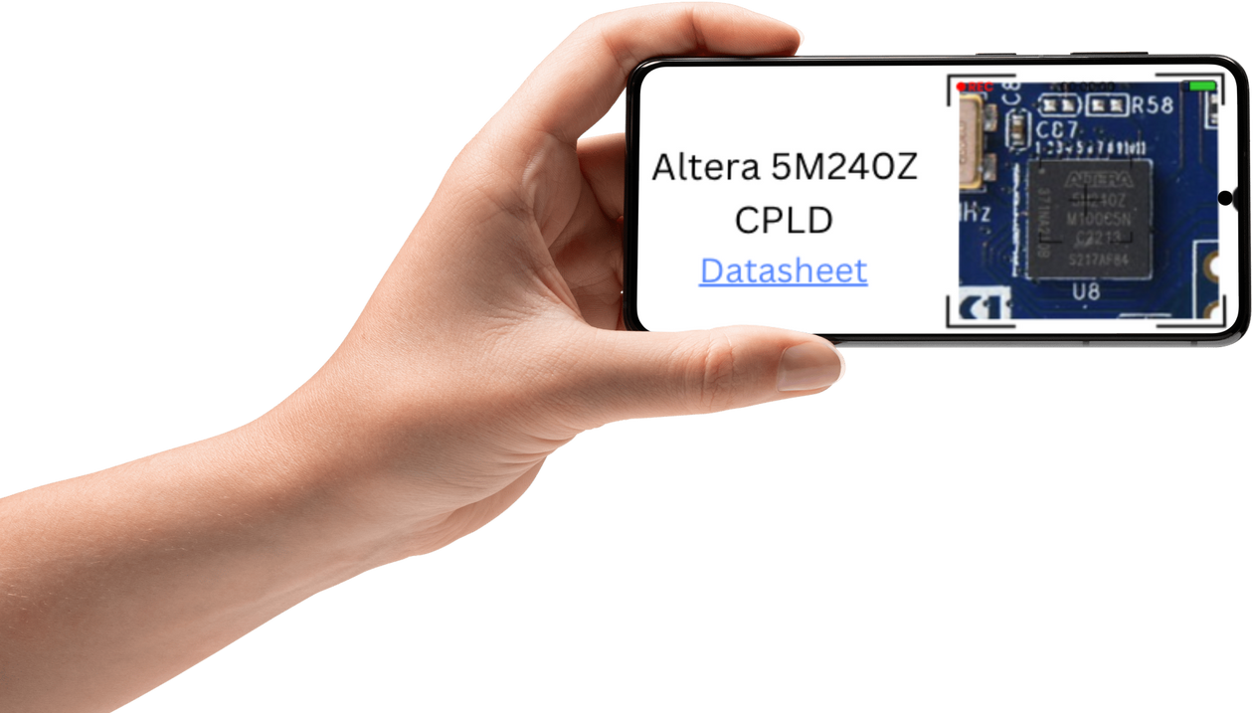
“A CircuitScan away from knowing”

Slide 5
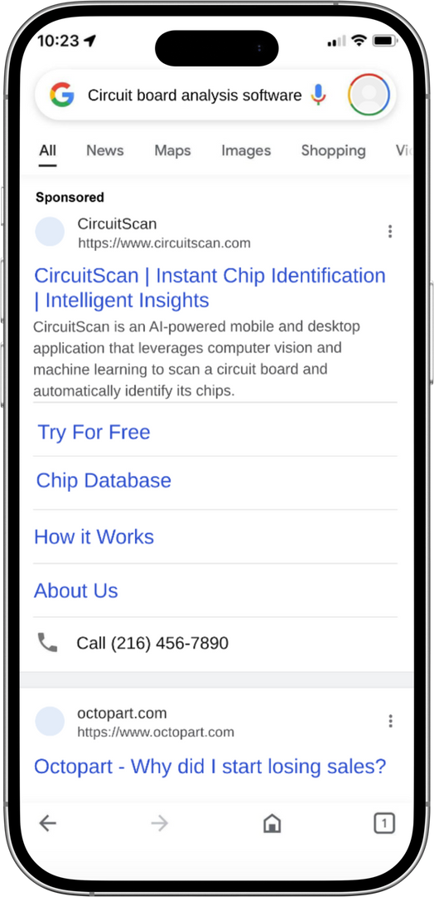
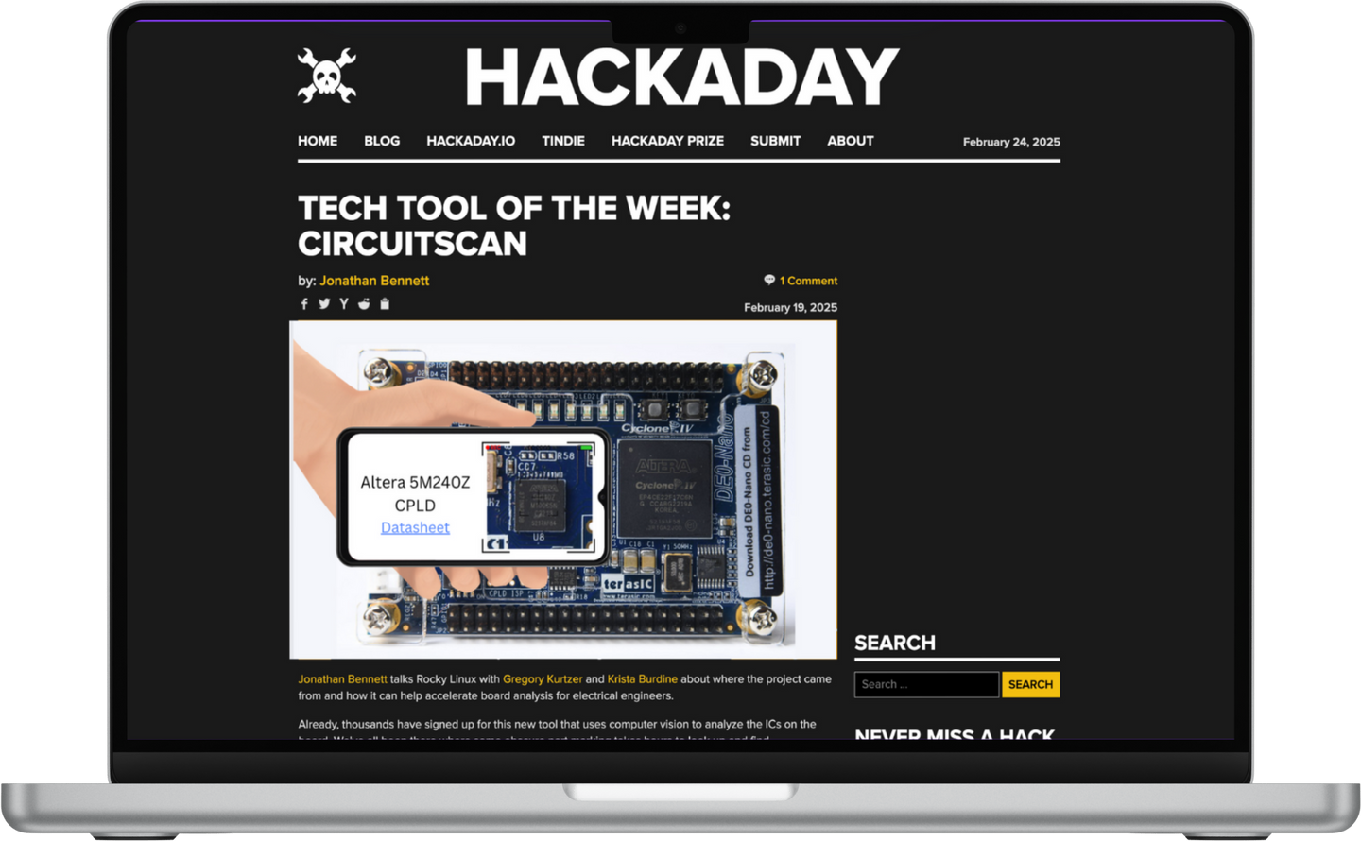
USER MARKETING

Slide 6
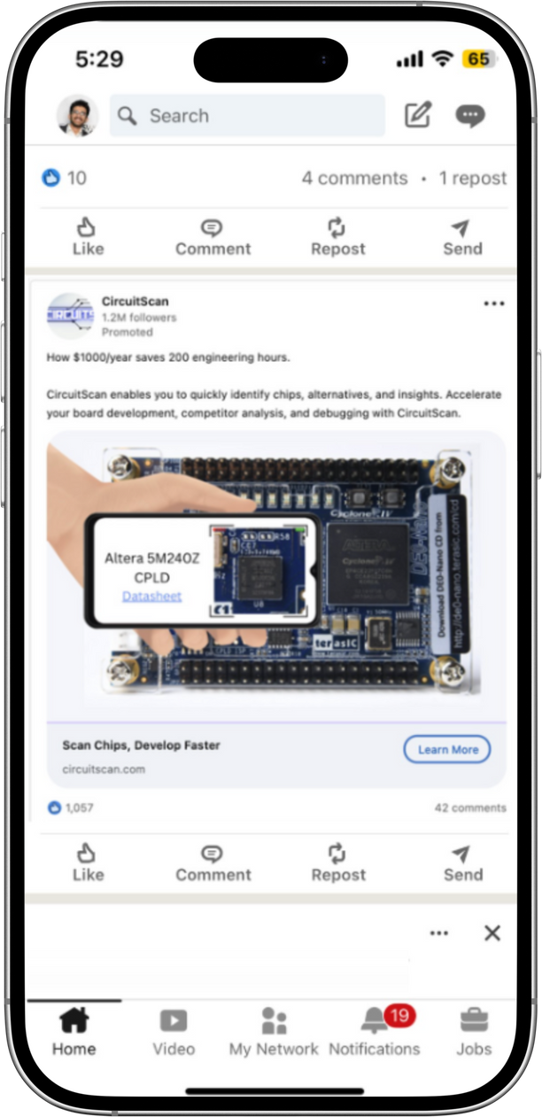
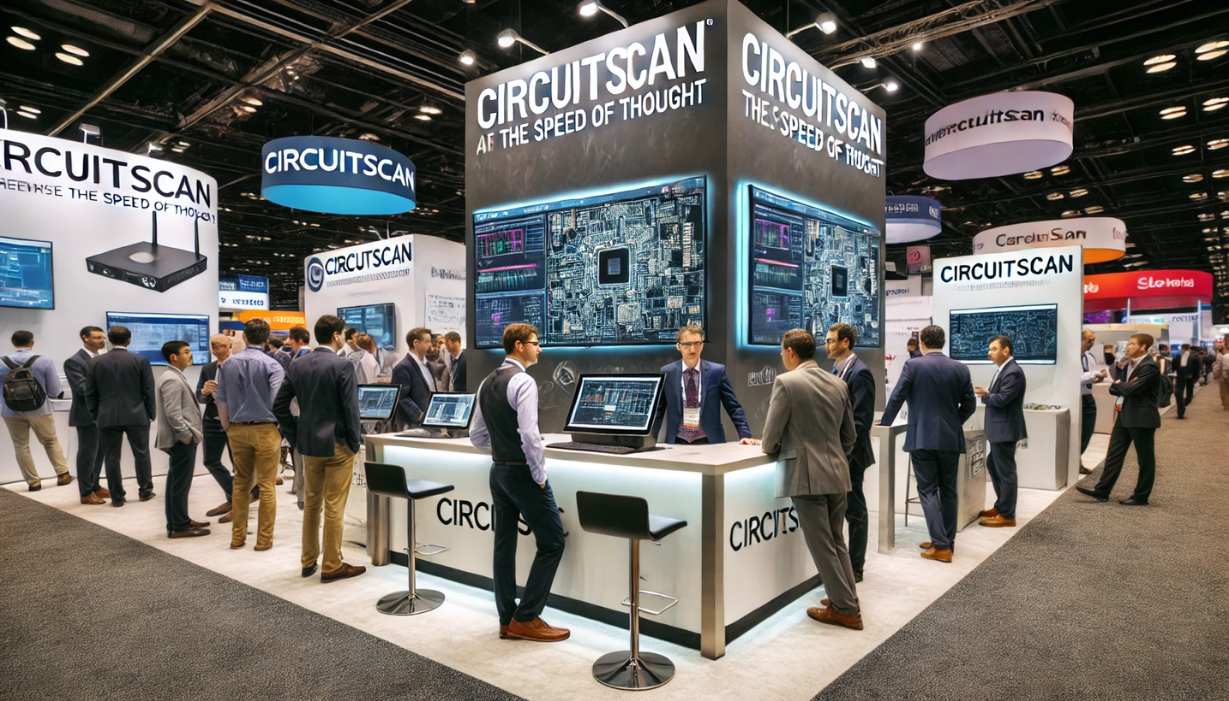
EXECUTIVE MARKETING

Slide 7
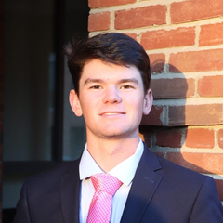
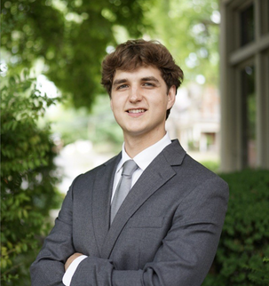



TEAM
Adam Gilmore
CEO / COO
Patrick
Carigan
CFO
Shahil Merchant
CTO
Nyah Funderburke
CMO
Shavonna Simpson
CSO
With Growth
Software Engineer
With Growth
UI/UX Engineer
With Growth
AI Engineer
With Growth
Sales Engineer
Outsourced
Compliance
Outsourced
Legal
Outsourced
HR
Outsourced
Accounting

Slide 8
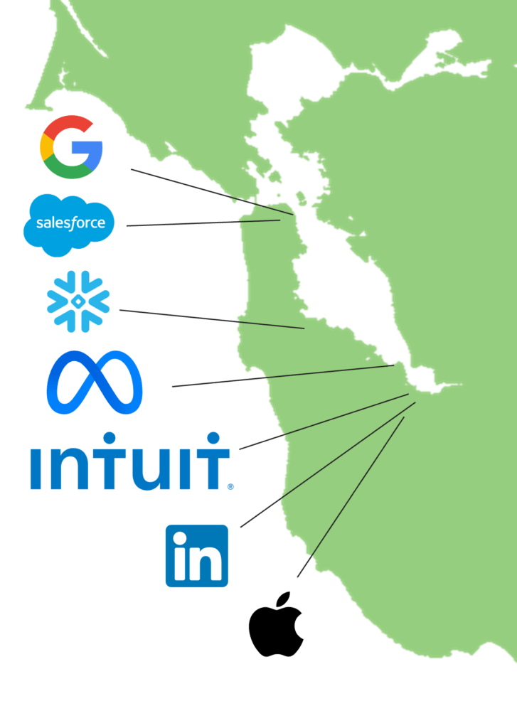








HOME: SILICON VALLEY
42%
US Semiconductor Revenue
41%
Total VC money in US
30%
Residents work in tech

Slide 9
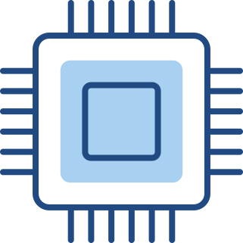


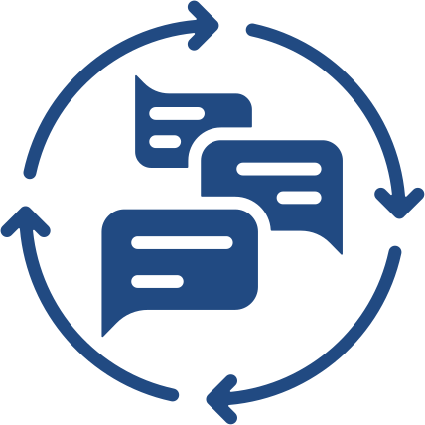


DAILY OPERATIONS
Internal
External
Update Software
Customer Meetings
Evolve Sales Strategy
Marketing
Procure Leads
Gather Feedback

Slide 10






PARTNERS
Chip Marketplaces
Chip Manufacturers

Slide 11

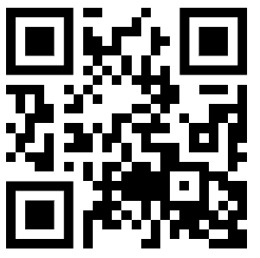



THANK YOU
216-456-7890
TEAM@CIRCUITSCAN.COM
90 SEMICONDUCTOR DR
CIRCUITSCAN.COM

